Slide 1
Preventing Catheter-Associated Urinary Tract Infection: Translating Research into Practice
Sanjay Saint, MD, MPH
Professor of Medicine
Ann Arbor VA Medical Center
University of Michigan Medical School
Notes:
I would like to begin by acknowledging my collaborators.

Slide 2
Healthcare-Associated Infection (HAI)
At least 20% of episodes are preventable; perhaps as much as 70% (Harbath et al. J Hosp Infect 2003)
Medicare no longer reimburses U.S. hospitals for the additional costs of certain infections
Preventive practices are variably used
Infection control is a good model for understanding translation – both successes and failures

Slide 3
Overview
Catheter-Associated UTI
Background
Prevention
Translating Research into Practice
Conclusions

Slide 4
Urinary Catheter-Related Infection: Background
Urinary tract infection (UTI) causes ~ 40% of hospital-acquired infections
Most infections due to urinary catheters
Up to 25% of inpatients are catheterized
Leads to increased morbidity and costs
Notes:
Urinary tract infection causes over 40% of hospital-acquired infections, making it the most common nosocomial infection.
Most of these infections are due to urinary catheters.
25% of inpatients are catheterized at some time during their hospital stay.
Nosocomial UTI leads to increased morbidity and increased costs.

Slide 5
Clinical Manifestations of CAUTI
Clinical manifestations vary greatly
Asymptomatic bacteriuria ⇒ overwhelming sepsis
Symptomatic UTI:
Lower abdominal, suprapubic, or flank pain
Systemic symptoms: nausea, vomiting, fever

Slide 6
Burden-of-illness
Of patients who receive urethral catheters:
Bacteriuria rate is ~5% per day
Among those with bacteriuria:
~10% will develop symptoms of UTI
Up to 3% will develop bacteremia
Direct medical costs:
Symptomatic UTI: ~$600 per episode
Bacteremia: ~$3000 per episode (Tambyah et al. ICHE 2002; Saint AJIC 1999)

Slide 7
Centers for Medicare & Medicaid Services (CMS) Rule Changes: 1 October 2008
CMS now holds U.S. hospitals accountable for not preventing certain hospital-acquired complications
CMS required to choose at least 2 conditions that:
are high cost and/or high volume; and
could reasonably have been prevented through the application of evidence-based guidelines

Slide 8
CMS Chose More Than 2 Conditions
Catheter-associated UTI
Vascular catheter-associated infection
Retained object during surgery
Air embolism
Blood incompatibility
Pressure ulcers
Surgical Site Infections after certain surgical procedures
Falls and Trauma
Manifestations of Poor Glycemic Control
DVT or PE following certain orthopedic surgeries

Slide 9
Cost Implications of CMS Rule Change
University of Michigan patient with pneumonia:
Without complication or comorbidity (CC): $6899
With CA-UTI (CC): $8495 (~$1600 more)
University of Colorado patient with acute MI:
Without CC: $5436
With CA-UTI (CC): $6721 (~$1300 more)
(Wald and Kramer. JAMA 12/19/07)

Slide 10
Urinary Catheter-Related Infection: Pathophysiology
Organisms enter the bladder by 3 ways:
1) At time of catheter insertion
2) Through the catheter lumen (from a colonized drainage bag)
3) Along external surface of the catheter (migrate along the catheter-mucosal interface)
(Tambyah, Halvorson, Maki. Mayo Clin Proc 1999)

Slide 11
Urinary Catheter-related Infection: Pathophysiology
Intraluminal Extraluminal
Detrusor spasm Shedding of cells Bacteremia
Leakage Obstruction Fever
(+) UA Hypotension
Bladder infection with inflammation

Slide 12
The Indwelling Urinary Catheter: A “1-Point” Restraint?
Satisfaction survey of 100 catheterized VA patients:
42% found the indwelling catheter to be uncomfortable
48% stated that it was painful
61% noted that it restricted their ADLs
2 patients provided unsolicited comments that their catheter “hurt like hell”
(Saint et al. JAGS 1999)

Slide 13
Catheter-Associated Urinary Tract Infection
Background
Prevention

Slide 14
Prevention of Catheter-Associated UTI
Make sure the catheter is indicated
Adhere to general infection control principles (eg, aseptic insertion, proper maintenance, hand hygiene, education, feedback)
Remove the catheter as soon as possible
Consider other methods of prevention

Slide 15
UTI Prevention Rule #1: Make Sure the Patient Really Needs the Catheter
Appropriate indications
Bladder outlet obstruction
Incontinence and sacral wound
Urine output monitored
Patient’s request (end-of-life)
During or just after surgery
(Wong and Hooton - CDC 1983)
(Jain. Arch Int Med 95)

Slide 16
One Reason Catheters Are Used Inappropriately
(Saint S, Wiese J, Amory J, et al. Am J Med 2000)
Notes:
As seen in this table, 18% of medical students, 22% of interns, 28% of residents, and 35% of attending physicians were unaware that the patients that they were responsible for had an indwelling catheter.

Slide 17
Prevention of Catheter-Associated UTI
Make sure the catheter is indicated
Adhere to general infection control principles (eg, aseptic insertion, proper maintenance, hand hygiene, education, feedback)
Remove the catheter as soon as possible
Consider other methods of prevention

Slide 18
Use Proper Aseptic Technique for Catheter Insertion
NEJM Videos in Clinical Medicine:
Male Urethral Catheterization T. W. Thomsen and G. S. Setnik - 25 May, 2006
Female Urethral Catheterization R. Ortega, L. Ng, P. Sekhar, and M. Song - 3 Apr, 2008
Goal is to avoid contamination of the sterile catheter during the insertion process
Should not assume that the healthcare workers inserting urinary catheters know how to do so

Slide 19
Prevention of Catheter-Associated UTI
Make sure the catheter is indicated
Adhere to general infection control principles (eg, aseptic insertion, proper maintenance, hand hygiene, education, feedback)
Remove the catheter as soon as possible
Consider other methods of prevention

Slide 20
Early Removal of Indwelling Catheters: Summary of the Evidence
14 studies have evaluated urinary catheter reminders and stop-orders (written, computerized, nurse-initiated)
Significant reduction in catheter use
Significant reduction in infection
No evidence of harm (ie, re-insertion) (Meddings J et al. Clin Infect Dis 2010)
Notes:
Because of these increased morbidity and costs, several preventive strategies have been attempted.
Silver-coated catheters are one such intervention used to prevent catheter-related infection.
The rationale for using silver is that this substance has in vitro antibacterial activity and is commonly used to prevent infection in burn patients.
The efficacy of silver alloy catheters in preventing urinary tract infection was shown in a recent meta-analysis of randomized trials that we performed.

Slide 21
Prevention of Catheter-Associated UTI
Make sure the catheter is indicated
Adhere to general infection control principles (eg, aseptic insertion, proper maintenance, hand hygiene, education, feedback)
Remove the catheter as soon as possible
Consider other methods of prevention

Slide 22
Prevention of CAUTI using Antimicrobial Catheters
Different antimicrobial urinary catheters have been evaluated in patients:
Silver (either alloy or oxide)
Nitrofurazone-releasing
Notes:
Because of these increased morbidity and costs, several preventive strategies have been attempted.
Silver-coated catheters are one such intervention used to prevent catheter-related infection.
The rationale for using silver is that this substance has in vitro antibacterial activity and is commonly used to prevent infection in burn patients.
The efficacy of silver alloy catheters in preventing urinary tract infection was shown in a recent meta-analysis of randomized trials that we performed.

Slide 23
Cochrane Review of Antimicrobial Catheters (Schumm & Lam. Cochrane Database 2008)
23 trials involving 5236 hospitalized adults in 22 parallel group trials met inclusion criteria
Conclusions: “…Silver alloy (antiseptic) coated or nitrofurazone-impregnated (antibiotic) urinary catheters might reduce infections in hospitalised adults … but the evidence was weak.”
“Larger, more scientifically rigorous, trials are needed on whether catheters impregnated with antibiotics or antiseptics reduce infection.”

Slide 24
Other Methods for Preventing CA-UTI
Alternatives to the indwelling catheter
Bladder ultrasound
Intermittent catheterization
Condom catheter

Slide 25
Recent Guidelines on CAUTI Prevention

Slide 27
Linda Greene, RN, MS, CIC
James Marx, RN, MS, CIC
Shannon Oriola, RN, CIC, COHN

Slide 28
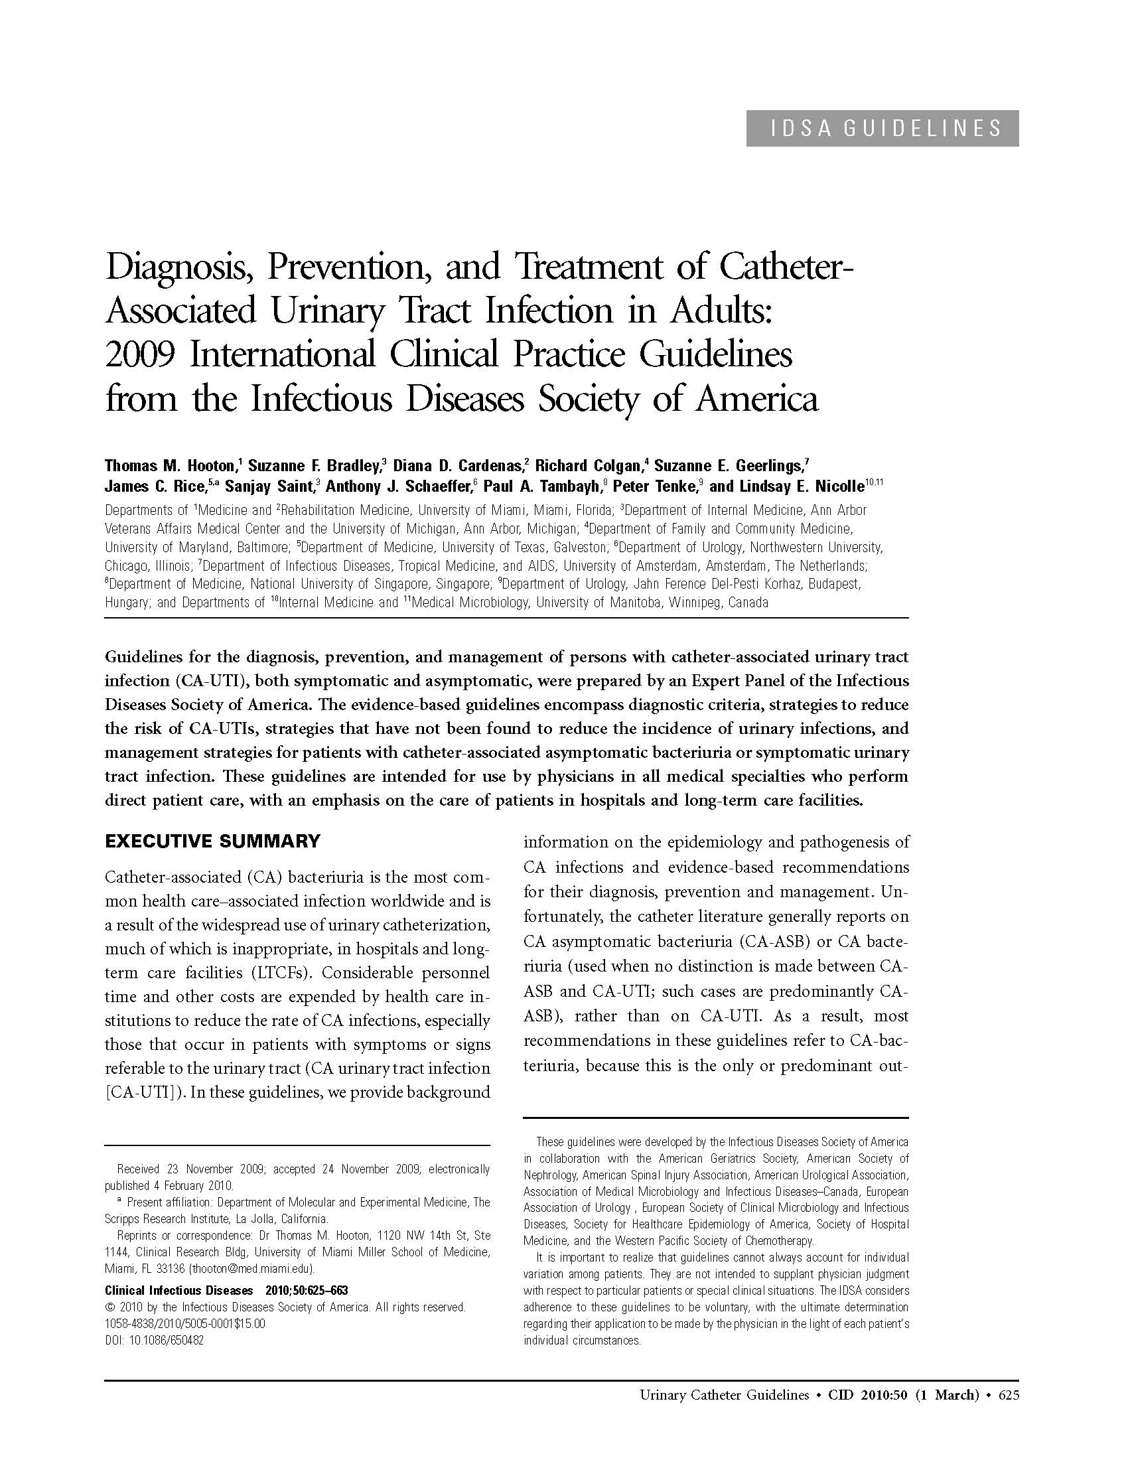

Slide 30
CA-UTI Prevention: Concise Summary of Recommendations
Adherence to infection control principles (eg, aseptic insertion, proper maintenance, education) is important
Bladder ultrasound may avoid indwelling catheterization
Condom or intermittent catheterization in appropriate pts
Do not use the indwelling catheter unless you must !
Early removal of the catheter using reminders or stop-orders appears warranted
(Saint et al. Jt Comm J Qual Saf 2009)

Slide 31
Overview
Catheter-Associated UTI
Background
Prevention
Translating Research into Practice
Conclusions

Slide 32
What are Hospitals Using to Prevent CA-UTI?
National survey of U.S. hospitals (focused on device-related infection)
719 hospitals surveyed (Spring 2005)
Lead Infection Control Professional filled out the survey
72% response rate
(Saint et al. Clin Infect Dis 2008)

Slide 33
Urinary Catheter-Related Infection Prevention Practices
Practice | Regularly using
Bladder ultrasound scanner | 30%
Antimicrobial catheters | 30%
Condom catheters in men | 14%
Urinary catheter reminder | 9%
Antimicrobials in the drainage bag | 3%
(Saint et al. Clin Infect Dis 2008)

Slide 34
Translating Research Into Practice
No common strategy used in hospitals to prevent UTI
Less than 10% of U.S. hospitals using catheter reminders or stop-orders
Next Step: Evaluate why interventions are used in some hospitals but not in others
Theoretical underpinning: “Diffusion of Innovation”

Slide 35
“Diffusion of Innovation”: Background
Based on the work of Everett Rogers, PhD
Definitions:
Diffusion = spread
Innovation = a new practice
Many innovations diffuse slowly

Slide 36
Consistently Using Evidence-Based Practices Remains a Challenge…

Slide 37
Hand Hygiene Compliance in Healthcare Workers (Erasmus et al. Infect Control Hosp Epidemiol March 2010)
Systematic review of 96 studies
Overall median compliance of 40%
Lower rates in physicians (32%) than nurses (48%)
Lower rates “before” (21%) patient contact rather than “after” (47%)

Slide 38
Given this Gap Between What Should Be Done and What Is Done…
Focus on “implementation science”
“The scientific study of methods to promote the systematic uptake of research findings into routine practice” (Eccles & Mittman. Implementation Science. Feb 2006)
Synonyms:
“T3” translation
Knowledge utilization

Slide 39
Once discoveries are made, how can we better implement evidence-based practices in infection prevention?

Slide 40
Why Are Some Hospitals Better than Others in Preventing Infection?
Quantitative Qualitative
phase phase
Part 1 | Part 2 | Part 3
Surveyed infection control personnel at 719 U.S. hospitals | Phone interviews with key informants at 14 hospitals | Site visits at 6 hospitals
(Krein et al. Am J Infect Cont 2006)

Slide 41
Why Use Qualitative Methods?
Quantitative methods help us answer the question of ‘what’ is happening
Qualitative methods help us answer ‘why’
(Forman et al. AJIC 2008)
Notes:
JANE
Artistic = Intuitive and non-linear thinking
Interpreting the meaning of e.g., “size"

Slide 42
Main UTI Qualitative Theme
Urinary catheter-related infection is a low priority, but timely removal of catheters considered important
(Saint et al. Infect Cont Hosp Epid 2008)
Notes:
Since qualitative research focuses on discovering underlying “themes”, I will discuss one of these themes,
Namely…
Urinary catheter-related infection is a low priority, but timely removal of the catheters was considered important
I provide illustrative quotes to explain this theme on the next few slides.

Slide 43
Urinary catheter-related infection is a low priority …
A hospital epidemiologist: “ I [nor] anyone else has really been able to get ourselves that excited about trying to prevent bladder colonization. But….I think that we probably should try to be more proactive about getting the catheters out.”
Notes:
One of the hospital epidemiologists we interviewed stated:
“ I [nor] anyone else has really been able to get ourselves that excited about trying to prevent bladder colonization. But….I think that we probably should try to be more proactive about getting the catheters out.”

Slide 44
…but timely catheter removal considered important
Hospitals using reminders highlighted non-infectious reasons for catheter removal: patient dignity & mobility, and length of stay
Some pushback from nurses
A nurse: “…convenience unfortunately is a high priority …especially with urinary catheters…the workload will be increased if you have to take [patients] to the bathroom or you have to change their bed a little more often ….”
Notes:
Interestingly, we found that hospitals using urinary catheter reminders tended to highlight non-infectious reasons for catheter removal: such as patient dignity, patient mobility, and length of stay
However, there was some pushback about removing catheters, especially from the nursing staff.
One of the nurses told us: “…convenience unfortunately is a high priority …especially with urinary catheters…the workload will be increased if you have to take [patients] to the bathroom or you have to change their bed a little more often ….”

Slide 45
…but timely catheter removal considered important
Nurse buy-in critical
A physician administrator: “Because the nurses on the geriatrics unit wanted to have their patients regain mobility…they viewed ambulation and mobility as a very important goal…versus the other units where the nurses didn’t necessarily feel that was a real goal in the patient’s plan for that day.”
Partnering with a nurse leader is key
Notes:
Nurse buy-in is therefore important.
As one physician administrator concluded: “Because the nurses on the geriatrics unit wanted to have their patients regain mobility…they viewed ambulation and mobility as a very important goal…versus the other units where the nurses didn’t necessarily feel that was a real goal in the patient’s plan for that day.”

Slide 46
Urinary Catheters Often Placed in the Emergency Department
Avoiding insertion also important
An Infection Control Nurse: “our other barrier is the Emergency Department and this is where most Foleys are placed. . . . Doctors forget to look under the sheets to say, ‘Oh yeah, there’s a Foley there’ and … the nurses aren’t going to take the initiative. . . ”
Initiatives to avoid insertion should include emergency department personnel (same for aseptic insertion)
(Fakih et al. Acad Emerg Med March 2010)
Notes:
Since qualitative research focuses on discovering underlying “themes”, I will discuss one of these themes,
Namely…
Urinary catheter-related infection is a low priority, but timely removal of the catheters was considered important
I provide illustrative quotes to explain this theme on the next few slides.

Slide 47
Qualitative UTI Themes
1) Urinary catheter-related infection is a low priority, but timely removal of catheters considered important
2) Identifying a committed “champion” facilitated prevention activities in several sites
3) Small hospital-specific pilot studies are important in deciding whether or not to use antimicrobial catheters
(Saint et al. Infect Cont Hosp Epid 2008)

Slide 48
Barriers and Facilitators
Interested in overarching qualitative themes
These themes spanned the hospital-acquired infections studied (UTI, CLABSI, VAP)
Specifically interested in identifying barriers to and facilitators of the use of preventive practices

Slide 49
Findings: Key Barriers
Active resisters: people who prefer doing things the way they have always done them
Organizational constipators: passive-aggressives who undermine change without active resistance (Saint et al. Joint Comm Journal Qual Safety 2009)
Culture of Mediocrity (rather than Excellence)
Notes:
I have divided these overarching themes into barriers and facilitators. First the barriers: One of the important barriers we discovered [HIT RETURN FOR NEXT BULLET] was the presence of organizational “constipators” who we define as passive-aggressive types who undermine change without active resistance. These individuals appear to be supportive of change but end up ‘gumming’ up the system, thereby requiring others to erect work-arounds to get by them. [HIT RETURN FOR NEXT BULLET]
Another important barrier was the presence of silos. These were either “Clinical/work-unit silos”: in which everyone is in their own little world; And “Economic silos” in which the cost of the practice comes from a different bucket than where the benefits flow

Slide 50
What is a Culture of Excellence?
Hospital wants to be superb
Employees are rewarded for exemplary work
Employees describe their hospital as “the best” and enjoy working there
Clear goals that can be achieved
Notes:
I have divided these overarching themes into barriers and facilitators. First the barriers: One of the important barriers we discovered [HIT RETURN FOR NEXT BULLET] was the presence of organizational “constipators” who we define as passive-aggressive types who undermine change without active resistance. These individuals appear to be supportive of change but end up ‘gumming’ up the system, thereby requiring others to erect work-arounds to get by them. [HIT RETURN FOR NEXT BULLET]
Another important barrier was the presence of silos. These were either “Clinical/work-unit silos”: in which everyone is in their own little world; And “Economic silos” in which the cost of the practice comes from a different bucket than where the benefits flow

Slide 51
Culture of Mediocrity
Happy to be “average”
Constipators are prevalent
Leadership is considered ineffective
Over-performers are rewarded by ….
Underperformers are not held accountable
Notes:
I have divided these overarching themes into barriers and facilitators. First the barriers: One of the important barriers we discovered [HIT RETURN FOR NEXT BULLET] was the presence of organizational “constipators” who we define as passive-aggressive types who undermine change without active resistance. These individuals appear to be supportive of change but end up ‘gumming’ up the system, thereby requiring others to erect work-arounds to get by them. [HIT RETURN FOR NEXT BULLET]
Another important barrier was the presence of silos. These were either “Clinical/work-unit silos”: in which everyone is in their own little world; And “Economic silos” in which the cost of the practice comes from a different bucket than where the benefits flow

Slide 52
Key Facilitators
Notes:
I have divided these overarching themes into barriers and facilitators. First the barriers: One of the important barriers we discovered [HIT RETURN FOR NEXT BULLET] was the presence of organizational “constipators” who we define as passive-aggressive types who undermine change without active resistance. These individuals appear to be supportive of change but end up ‘gumming’ up the system, thereby requiring others to erect work-arounds to get by them. [HIT RETURN FOR NEXT BULLET]
Another important barrier was the presence of silos. These were either “Clinical/work-unit silos”: in which everyone is in their own little world; And “Economic silos” in which the cost of the practice comes from a different bucket than where the benefits flow

Slide 53
The Importance of Effective Leadership
Applies not only to the CEO…
Getting the right people on the bus and in the right seats: identify and support “champions”
Works well with other disciplines
Examples: IPs, hospital epidemiologists, CMOs, patient safety officers
Notes:
I have divided these overarching themes into barriers and facilitators. First the barriers: One of the important barriers we discovered [HIT RETURN FOR NEXT BULLET] was the presence of organizational “constipators” who we define as passive-aggressive types who undermine change without active resistance. These individuals appear to be supportive of change but end up ‘gumming’ up the system, thereby requiring others to erect work-arounds to get by them. [HIT RETURN FOR NEXT BULLET]
Another important barrier was the presence of silos. These were either “Clinical/work-unit silos”: in which everyone is in their own little world; And “Economic silos” in which the cost of the practice comes from a different bucket than where the benefits flow

Slide 54
Key Behaviors of Effective Infection Prevention Leaders
Cultivated a culture of clinical excellence
Developed a clear vision
Successfully conveyed that to staff
Inspired staff
Motivated and energized followers
Some, not all, where charismatic
(Saint et al. Infect Cont Hosp Epid 2010)
Notes:
The person doing the influencing is called a leader

Slide 55
Key Behaviors of Effective Infection Prevention Leaders
Solution-oriented
Focused on overcoming barriers rather than complaining
Dealt directly with resistant staff
Thought strategically while acting locally
Planned ahead leaving little to chance; politicked before crucial issues came up for a vote in committees
Kept their eye on the prize: improving patient care
(Saint et al. Infect Cont Hosp Epid 2010)
Notes:
The person doing the influencing is called a leader

Slide 56
Another Key Facilitator: Collaboratives
Collaboratives: align clinical silos and goals
Examples: 100K Lives Campaign, Keystone
Notes:
On the other hand, we found “collaboratives” –to be a powerful facilitator perhaps because they align clinical silos and goals.
There are several tools utilized by collaboratives that may account for their success, including:
CEO buy-in
Spotlighting of an issue
Identifying a champion (within the organization)
And using off-the-shelf solutions (that have already been developed) PAUSE
Now for the Discussion…

Slide 57
Key Facilitator: Collaboratives
Tools used by collaboratives:
CEO buy-in
Spotlighting an issue
Identifying a champion within the organization
Using off-the-shelf solutions that have already been developed
Notes:
On the other hand, we found “collaboratives” –to be a powerful facilitator perhaps because they align clinical silos and goals.
There are several tools utilized by collaboratives that may account for their success, including:
CEO buy-in
Spotlighting of an issue
Identifying a champion (within the organization)
And using off-the-shelf solutions (that have already been developed) PAUSE
Now for the Discussion…

Slide 58
Overview
Catheter-Associated UTI
Translating Research into Practice
Conclusions

Slide 59
Conclusions
CAUTI is a common and costly patient safety problem
Several practices appear to decrease CAUTI
Collaborative efforts underway in Michigan & elsewhere
Understand the implementation process and tailor as appropriate: one size unlikely to fit all
Leadership is important in preventing infection
Preventing CAUTI is a team sport
Notes:
I have divided these overarching themes into barriers and facilitators. First the barriers: One of the important barriers we discovered [HIT RETURN FOR NEXT BULLET] was the presence of organizational “constipators” who we define as passive-aggressive types who undermine change without active resistance. These individuals appear to be supportive of change but end up ‘gumming’ up the system, thereby requiring others to erect work-arounds to get by them. [HIT RETURN FOR NEXT BULLET]
Another important barrier was the presence of silos. These were either “Clinical/work-unit silos”: in which everyone is in their own little world; And “Economic silos” in which the cost of the practice comes from a different bucket than where the benefits flow

